Slide 1

Data Analytics for UK Air Quality
Student Name: Nazrana Patel ID:77288206

Slide 2
Abstract -
Data analytics and data visualization machine learning method has been suggested for prediction of air quality analysis, for the analysis of future forecasting the deep learning method has been developed. Primary data has been collected from Kaggle repository and secondary data has been collected from published research article. Methodology of this research based on machine learning and data mining approach to visualize and analyse the dataset of air quality. The development of smart cities IOT system enable the environmental protection agency to make attention to achieve the great outcomes of air pollution detection, IOT system connected in real time wireless network by using the internet 5G technology. By constructing machine learning algorithm which present the data analytics technique to estimate and validate the method of air quality determining and prediction.

Slide 3
Introduction
UK air quality data analytics using the machine learning algorithm has been, used widely to predict the air quality and level of oxygen and nitrogen level in atmosphere, to predict and analyse the various protocols of the field of data science and analysis. (Borrajo, L.Cao, R., 2020). For monitoring and analyzing the smart cities air quality and level of air resistance in particular areas in different regions of UK. The problem of big data analytics which has been measures & analyzed based on different pattern. The size of population size based on mean and different data analysis which has been measured and analyzed on various machine learning prediction and statistical method has been applied to visualize the features. The method of real data sets and concerned the level of population and level of pollution which used to analyze the urban air cities measuring the mean square error, which measure the level of pollution and level of air quality with nitrogen and oxygen level. The concerned view of data analytics to visualize the different dataset pattern and dataset systematic view in order to view the various cities air quality which was based on UK cities. The temperature is greater than 30 C might be possible in least locations of UK.

Slide 4
  Background
(Rollo, F., Sudharsan, 2021) air quality sensor data acquisition to clean and monitor the air quality sensor data with the help of IOT system, smart cities and develop cities organized with IOT system that centrally connected with the internal internet technology of UK government to support the environment system. the primary development of air quality which used to monitor the importance of sustainable lifestyles with planned activity of corrective actions, the paper present the designed activity of end to end implementation of real world urban cities data collection which has been analyzed and predicted on machine learning and statistical method in order to achieve the data analytics framework. Various European project based in Italy and UK cities that uses to organize the smart cities with the help of smart machine learning and artificial intelligence based prediction method the low cost multi sensor IOT devices including LORA network setup with data collection of LORA server database, machine learning based anomaly detection method used to analyze the air cleaning, pollution detection, traffic crowd detection by using the sensor method.

Slide 5
  Aim and Objectives
Aim to produce high quality data analysis and visualization and objective is to achieve the high score of machine learning analysis.

Slide 6
  Rationale
(Kang, G.K., Gao, J.Z., 2018) various researcher has been predicted and analyzed the air quality system the most essential activities has been achieved to get the answer of urban industrial solution, air quality prediction and evaluation method has become the essential the evaluation air quality has been predicted on different time scale pattern in winter and summer season to analyze the temperature scaling pattern the approach of big data analytics application using the machine learning method to monitor the air quality forecasting the resultant air quality evaluation using artificial intelligence method including decision tree, deep learning method to analyze and predict the big data analytics by using the python programming tool. (Liao, Z., Peng, Y., 2014) the evaluation of urban healthcare system was analyzed on machine learning method, including crowd source and cloud based air quality indicators to achieve the resultant of air level of urban & smart cities, the helping aid technology which was based on AI technology IOT system deeply involved with this system to admire the technology which support the big data analytics system in real time sensor

Slide 7
  Contribution
The specialized and organized method monitor the work environmental including limited period of time, central effective decision making with data analytics with potential data analysis approach the research going to present the big data analytics in terms of monitor the air quality system with potential industrial workshops to analyst the big data problem in order, the effective decision making method with regional of shipping industry in Norway the performance of employees has been measured to analyze the risk factor of shipping company to manage the good and effective supply chain management. . Thus the air qualities in cities has been measure and analyzed through metrological sites, mobile data sources, crowdsourcing, including IOT sensor along with user body signals the artificial intelligence based smart urban cities measure the data quality data preparation has been achieved through the artificial intelligence method to support the healthcare department of internal cities zone.

Slide 8
Literature Review
(Zhou, Z., 2017) with the growing development of industries based on, the development of UK industries zones to view and visualize the various roles and pattern of industrial application to view the various data items in certain condition, the collection of data analytics to measure the air quality analysis with detail and temporal analysis to explore the major areas of pollution to find out the decision making to find the efficient solutions. The author designed with visual data analysis, to visualize the data analytics system in order to monitor the station of various system to check and predict the 2D plot by uses the hirerechail clustering method with multidimensional multiscaling method of statistical analysis framework including voronoi diagram with storyline visualization with various attributes of data analytics scaling to explore the time scale data. (Ivanova¹, D. Elenkov, A., 2019). This paper explores the machine learning prediction method for IOT platform to investigate the Raspberry PI to analyze the various of pollutants in the air based on big data analytics the conceptual model of proposed system analyzed and predict the experimental framework which was designed for verification and validation system that achieve to predict and analyze the statistical modeling based analysis method to analyze the IOT system data in real time sensing devices which was connected on the physical locations of the regions that connected with the internet technology system

Slide 9
Literature Review 2
. The dataset was provided to analyze and predict the executive environment agency which is ministry of environment and water in Bulgaria region. (Du, Y., Ma, C. 2017) the development of advanced multimodel scaling system in order to achieve the air quality and pollution quality monitory system of smart cities based in UK region, various smart cities connected with IOT based system to analyse and predict the system of motion that exists in the advance air system in UK. The air quality has been monitor and analyse with the help of machine learning modelling method and statistical scaling method, statistical regression model has been designed to view the future forecast of the existing dataset and also predict the different level of air in the region. The statistical explore the various integrated method such as map based view, calendar view and trend view to guide the analysis all of the mentioned visual method has been used to display the dataset location of interest and calendar of trends to view the discover linear periodical patterns, the system provides the various systematic tools that the data of size with different pattern of interest, the method of visual analytics that helps to assist the method of big data analytics in real world application such as air quality monitoring and mapping system. (Rollo, F., Sudharsan, 2021)

Slide 10
Methodology – Findings and discussion
Methodology of this research proposed to design the visualize and analyse the data analytics of UK air quality system. (Liao, Z., Peng, Y., 2014), the proposed method of this research based on quantitative method, the quantitative method based on machine learning and statistical method, machine learning prediction model used to measure and quantify the air quality performance with reflection of air temperature on different region.

Slide 11
Data Collection method
Primary data:
The concerned of primary data has been collected from kaggle repository, which was essential online web portal to access view and analyse the big data analytics with respect of machine learning prediction method. The primary data attributes as follows:
Date, Ozone, status, nitric oxide, status, nitrogen oxide, status, nitrogen oxide with gas, sulphur, status.
The dataset based on excel csv file, the primary focus is to analyse the ozone level and nitrogen level in the air to quantify the air quality system.
Secondary Data:
The secondary data has been collected from peer reviews journal article, published research journals sites, IEEE Xplore, IEEE conferences, ACM library and Google Scholar.

Slide 12
  Dataset interpretation
Dataset contain the UK air quality attributes which used to estimate the air quality level to determine the validate the air pollution level and clean air level by determining the machine learning based algorithm. Traffic increase day by day and by increasing the traffic the pollution has been increase and maximize the disease level. So machine learning smart analysis is able to highlight the air quality situation by determining the air situation. Now the IOT based system is able to detect the air quality which available on highways and national road to determine and predict the level of air and level of pollution within the air.

Slide 13
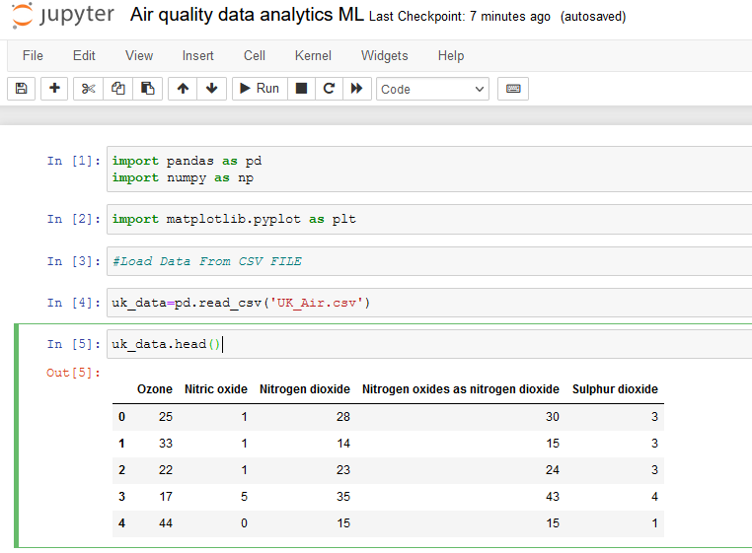
  Dataset attributes information

Slide 14
Level 1: MODELING SVM MACHINE LEARNING Python Programing Presentation

Slide 15
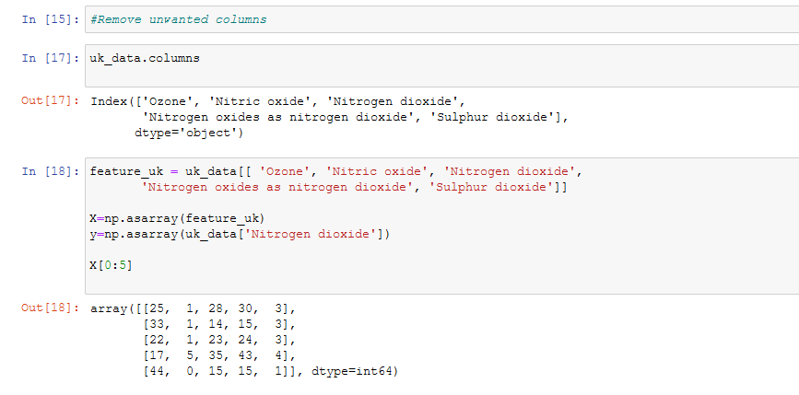
Removing unwanted columns

Slide 16
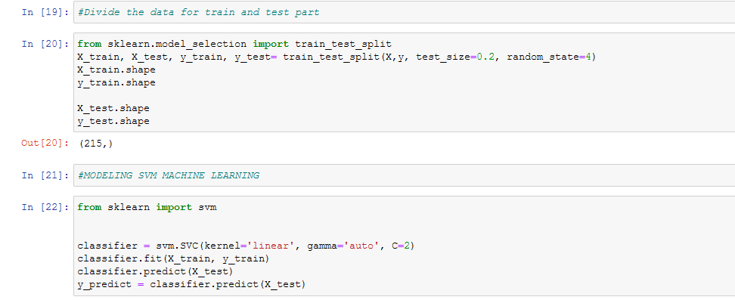
Testing & training dataset

Slide 17
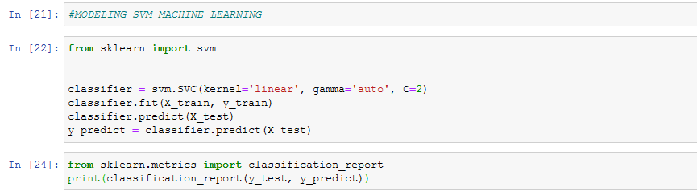
Modeling SVM ML

Slide 18
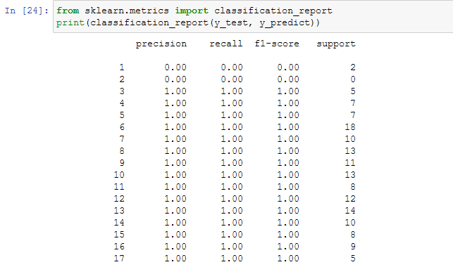
Outcomes

Slide 19

Accuracy score

Slide 20
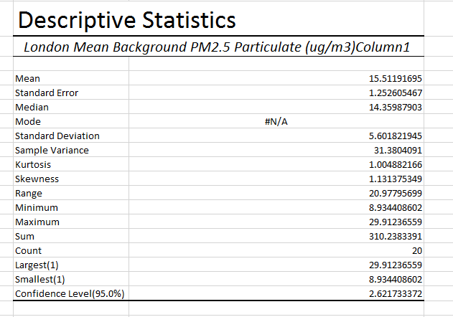
Level 2: Descriptive Statistics (Microsoft Excel)

Slide 21
  Dataset information
The dataset was shabby from London website. The dataset shows roadside and background average reading, the attribute contains, nitric oxide, nitrogen dioxide, oxides of nitrogen, ozone, the particular matter of dataset value PM10 to PM2.5 including sulphur oxide, the measuring with micrograms per cubic meter of air UG/m3 and the spreadsheet present the each row index level with readings falls in including chart showings with month and day.
Dataset contains London air quality average level on per month average level (Github 2020).

Slide 22
Level 3: Inferential statistics (Binomial THEOREM)
Binomial distribution using excel selecting the dataset attribute and select only 13 trails from the attribute value:
  Attribute selection from dataset
Dataset attribute: London Mean Background Sulphur Dioxide (ug/m3)
  Selection of trail from the dataset
X = 13
  Probability of dataset
P = 0.06

Slide 23
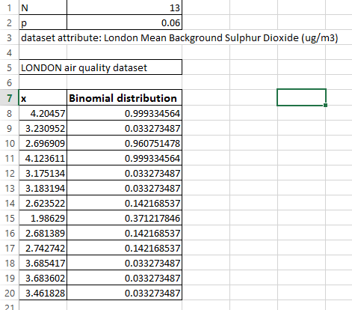
  Binomial theorem calculation in Excel

Slide 24
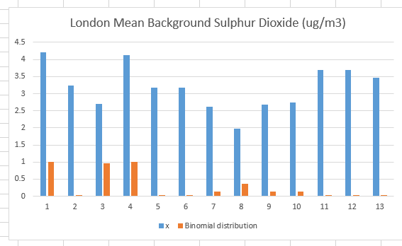
  Binomial theorem chart

Slide 25
Findings & Discussion
Visual analytics method has been proposed to measure the effective process of air quality dataset that become the hot research topic in these days. The processing of data analysis to analyse and quantify the big data analytics tools and technique which based on statistical modelling method, the proposed goal to achieve the outcomes of resultant attributes values has been achieve to organize the dataset. Data visualization method has been achieved with scatter plot, web based visual analytics, including spatial temporal with multi-dimensional features to monitor the air quality dataset. The GIS view used to view the spatial analysis of dataset in order the achieve the visual analysis the scatter plot interested way to analyse and predict them accordingly. The parallel plot of multi-dimensional method with inner tied newest approach which was able to configure the air quality analyst with different pattern of rules and regulations of statistical modelling

Slide 26
Research Finding
The standard unit colour mapping method with strategic view of air quality index. The standard interactive means helps to support the find out the standard error and mean squared error in the dataset. The air quality index dataset has been used to analyse and predict the spatial temporal statistics to analyse and predict the air quality pollution. (Daraio, E., Di Corso, E. 2018) machine learning supervised analytics method characterize the air quality measurement in order to achieve the air index that exists in the smart cities. The IOT enabled devices connected in real time environmental system to send the real time traffic positioning system that sustain to achieve the machine learning prediction method. Several cities has been made to analyze the smart cities air traffic including measurement of various air pollution system. the identification of casualties in the air quality system predicted decision making prediction system with the assistance of government officials that used to mitigate the air quality to support the development of smart cities in the urban region, different artificial intelligence based models has been previous developed by various research in order to quantify the method of sustainable development of air system.

Slide 27
Validation Research
The graphic visualization method obtain to present the outcomes of black boxing that undertake the method of end user level trust. The machine learning architecture present the visual analytics platform for making the custom level analytics of data to achieve the target result. The including and exclusion components has been used to predict the inclusion and exclusion method which ideally present the interactive visual analytics that linked with well define components for custom interactive analysis platform. The inclusion component used to predict and analyze the situational model of the air system in context of AI and machine learning predictions. (Marć, M., Tobiszewski, M., 2015) the machine learning summarizing tool effectively used to analyze the various statistical analysis such as mean value, median maximum value minimum value and quartile values. In the chain of air ozone layer level prediction ideally predict and analyze the air quality level of pollution which needs to develop the commonly air quality analytics and data frame. The segment of testing the level of air pollution and quantify the smart cities traffic which produces pollution from the vehicles, various electronic vehicle has been introduced in advance smart cities based in UK region. The cost of electronic vehicle comparatively low to measure and quantify the approach of data segment the operation of probability level testing which the aid of machine learning python prediction, monitoring level has been testing and verified the characterize method to obtain the automatic operation of summarize programs. The machine learning data summary present the state of the art report to ideally test and present the data analytic platform to test and quantify the approach which needs to address the problem

Slide 28
Recommendations –
(Mura, I., Franco, J.F 2020) the air quality testing and pollution quality has been tested with the help of machine learning models and deep learning modeling. The significant descriptive statistical analysis highly recommends by the WHO organization which support the environmental protection agency. The concentration of proposed WHO recommendation approach also suggest machine learning modeling to test and quantify the quantitative data analytics approach, various data visualization method has been used to plot the air quality data and analyze the future forecasting in order to deploy the system. (Huang, L., Zhu, Y., 2021) the numerical air quality data analytics modeling support the environmental protection agency which essentially used for analysis to control the air pollution, in the past the air pollution has been very serious issues now the issue has been resolved with the help of IOT system, IOT system support in the development of smart cities, and smart home applications and smart office equipment that used to restore the energy, cost and effort, various method of machine learning has been deployed such as Naïve bays testing and support vector machine modeling has been widely used in the past.

Slide 29
Conclusion and Future Work
Air pollution has been significant and challenging issues that posing a threat on human being health. Air quality data is very rare and does not easily accessible by the European countries, to enable the air quality monitoring system with centralized hub monitoring system in the smart cities air pollution quality data has been collected on real time sensor based IOT system that connected through the wireless sensor networks, the centralized and combined system monitor and analyse the air pollution and test the ozone level and nitrogen level and the level of hydrogen and oxygen level which needs to test the human being health as well. However the data fusion algorithm has been used to measure the air quality information from various sources to provide the sustainable air monitoring system. So it is concluded that data mining approach used for big data analytics with the help of mining algorithm and big data analytics and visualization it is recommends that machine learning and deep learning approach with statistical method of quantitative used to deploy the machine learning architecture

Slide 30
Bibliography
Borrajo, L. and Cao, R., 2020. Big-but-biased data analytics for air quality. Electronics, 9(9), p.1551.
Zhou, Z., Ye, Z., Liu, Y., Liu, F., Tao, Y. and Su, W., 2017. Visual analytics for spatial clusters of air-quality data. IEEE computer graphics and applications, 37(5), pp.98-105.
Ivanova¹, D. and Elenkov, A., 2019. Big Data Analytics for Air Quality Monitoring Assessment Based on IoT Platform.
Du, Y., Ma, C., Wu, C., Xu, X., Guo, Y., Zhou, Y. and Li, J., 2017. A visual analytics approach for station-based air quality data. Sensors, 17(1), p.30.
Rollo, F., Sudharsan, B., Po, L. and Breslin, J.G., 2021, September. Air quality sensor network data acquisition, cleaning, visualization, and analytics: A real-world iot use case. In Adjunct Proceedings of the 2021 ACM International Joint Conference on Pervasive and Ubiquitous Computing and Proceedings of the 2021 ACM International Symposium on Wearable Computers (pp. 67-68).

Slide 31
Thanks

